Slide 1
Electric vehicle integration into transmission system
Branka Vasikj
Sinisha Spasov

Slide 2
Power system challenges
The world’s electricity systems face a number of challenges, including
ageing infrastructure,
continued growth in demand,
integration of renewable energy sources and
electric vehicles.
A growing adoption of electrical mobility would coincide with other trends that put higher requirements on the network and power system, such as the increasing share of renewables and distributed generation, as well as demands for increasing energy efficiency.
Together these trends will drive the transition from traditional to smarter grids.

Slide 3
Impact of the electric vehicles on the transmission network
In low load (night) EVs have beneficial influence because they use the excess energy from thermal power plants
Optimal charging reduces operating costs for power system management:
Improved ability of the system to absorb energy from RES
Lower usage of expensive power during the peak demand
Opportunity for EVs to provide ancillary services
Reduced gas emissions and related costs

Slide 4
Electric vehicles as consumers and suppliers of electricity
Two-way flow of energy
Increased grid capacity
Improved reliability of the system
Facilitating power system management
On long term scale, EVs’ future role in the grid would be load-shifting and supplying power (Vehicle to Grid (V2G))

Slide 5
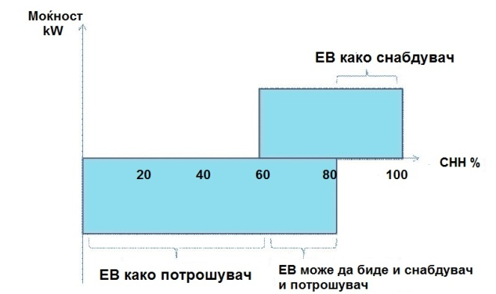
State of Charge
The electric vehicles relocate depending on the battery capacity (State of Charge - SoC). Varies in the range of 0 when the battery is fully discharged to 1 when the battery is fully charged, a 0-100%.
When SoC is below 60% - storing energy
When SoC is from 60% - 85% - storing and giving energy
When SoC is above 80-85% - giving energy

Slide 6
Grouping of electric vehicles
Grouped EVs behave like a large generator or a storage device.
An aggregator will group the electric vehicles so that they will have some benefit on the power grid.
The group is both a supplier and controlled consumer.
The group could conduct frequency control

Slide 7
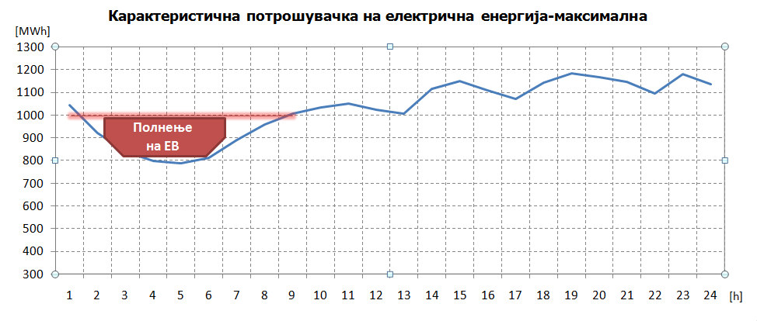
Diagram of electricity consumption for a typical winter day in Macedonia
Battery capacity – around 25 kWh
At the same time 33.000 EV can be plugged in the grid

Slide 8
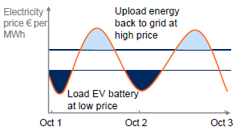
EVs as a part of the smart grid solution (1)
Price arbitrage
Taking advantage of electricity price differences in time
Electricity is traded on a per minute basis at energy exchanges
Risk due to battery aging and customer acceptance

Slide 9
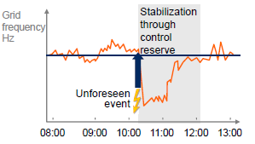
EVs as a part of the smart grid solution (2)
Control reserve
In case of unplanned grid fluctuations, positive or negative control reserve must be activated to stabilize the grid
Triggered charging or vehicle-to-grid upload can be used as such control reserve
High prices are paid for provisioning of such systems

Slide 10
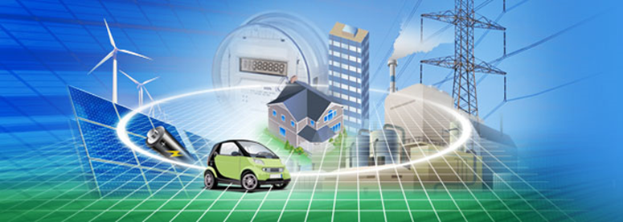
Electric vehicles in future
Fast charging stations will consume more energy at the same time.
To achieve SoC of 80% for 30 minutes, the EV will have to consume 50kW which is double the amount of todays gas stations.

Slide 11
Thank you! Ви благодарам!
www.mepso.com.mk

